Slide 1
Knight’s Pre-Law Association

Slide 2
1
WHO WE ARE

Slide 3
OUR FOUNDERS
Knight’s Pre-Law Association was founded by Hayley Siegel and Jordan Kronen in 2021. Hayley and Jordan wanted to establish a supportive community for pre-law students; moreover, create an organization that was much more laid back than PAD.

Slide 4
OUR MISSION
Our mission is to gather like-minded individuals to support one another, and give them access to resources in the pre-law field.

Slide 5
GOALS
COMMUNITY
INSIGHT
LSAT
NETWORKING
ADMISSIONS
RESUME
Create a supportive community of like-minded individuals
Allow our members to understand more about legal professions
Organize practice groups to improve scores
Provide our members networking and internship opportunities
Gain knowledge into the law school application process
Allow our members to have resume building experiences

Slide 6
MEETINGS
SPEAKER MEETINGS
SOCIALS
LSAT SESSIONS
Our speaker meetings are on a bi-weekly basis!
Our socials include on-campus and off-campus non-legal related activities.
We hold several LSAT study sessions throughout the semester.

Slide 7
2
MEMBERSHIP

Slide 8
MEMBERSHIP
WEBSITE
FORM
VENMO
SLACK
On our website is the membership form.
Fill out the membership form.
$60 yearly due
Venmo: @KPLA_UCF
(Include name, email, phone number in description)
Once the payment is received, you will be added to our slack.

Slide 9
WHAT DO YOUR DUES GO TOWARDS?
Off-campus and on-campus socials, fun contests, merchandise, & speaker related expenses.

Slide 10
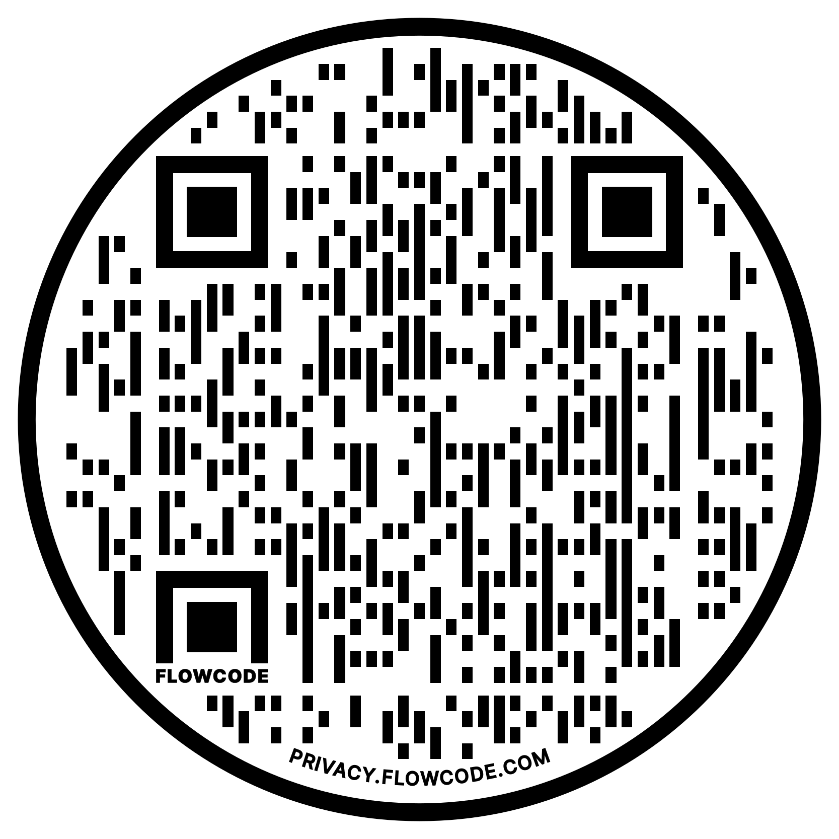
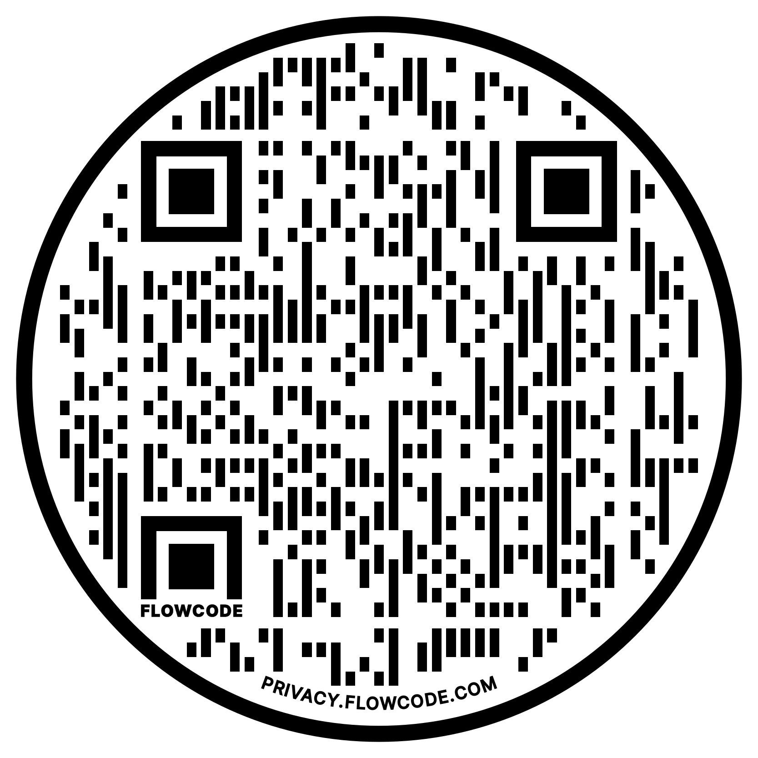
TAKE OUT YOUR PHONE
Subscribe to our calendar
Membership Form
Events Page

Slide 11
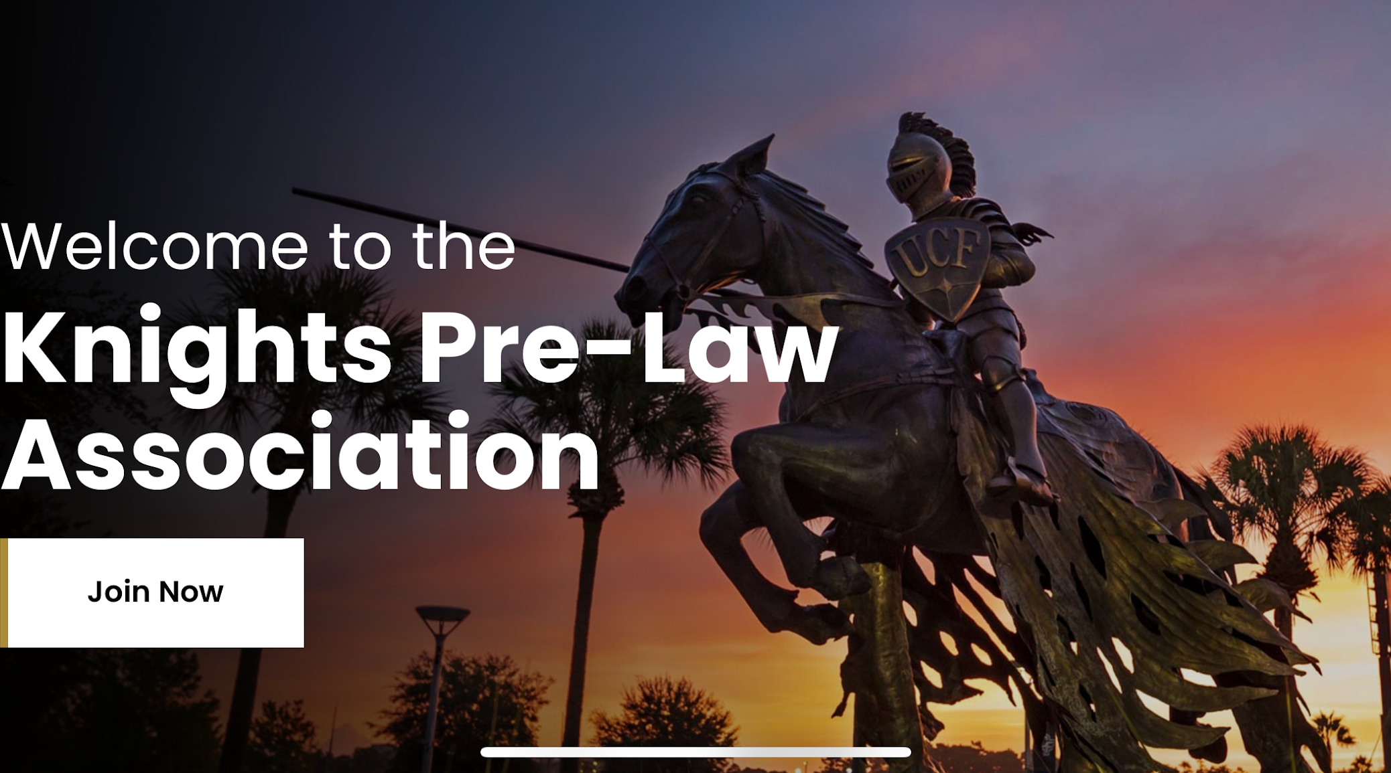
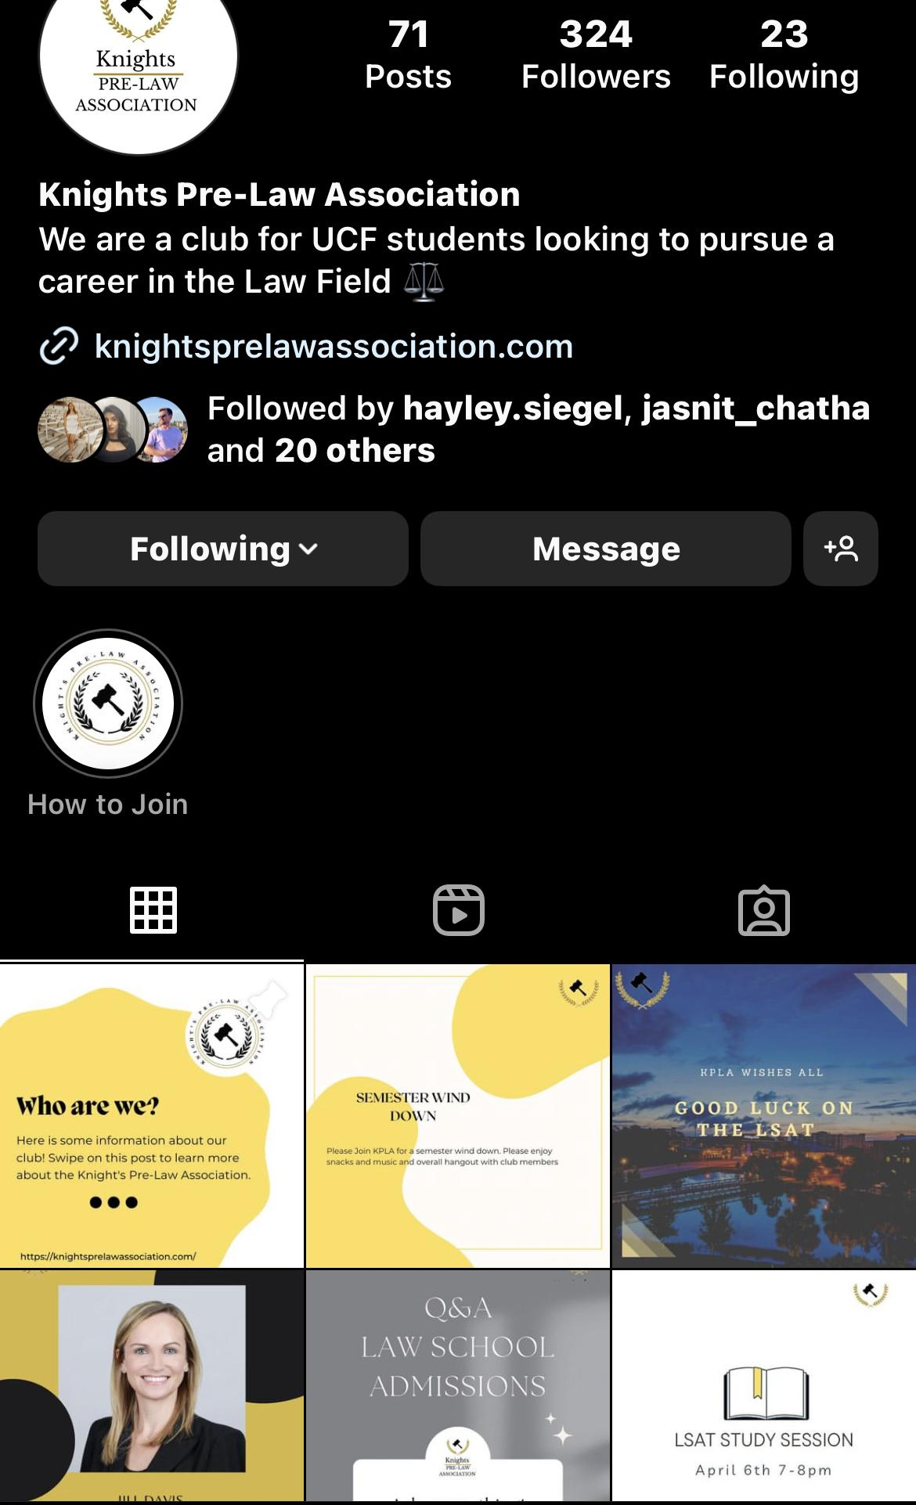
SOCIAL MEDIA
@knightsprelawassociation
www.knightsprelawassociation.com
Knight’s Pre-Law Association
Knight’s Pre-Law Association

Slide 12
Jordan L. Kronen Charitable Fund
In June 2021, Jordan, sadly passed away. Since his passing, his parents established the Jordan L. Kronen Charitable Fund. This fund is used to locate and support deserving causes in which Jordan was passionate about and that share his enjoyment of life and compassion toward others.

Slide 13
THANK YOU!
We are so excited to grow our KPLA community! We look forward to an amazing semester with all of you!

